Slide 1
Boosting Cross Border Entrepreneurial Activity in Social and Creative Industries Sector (Social&Creative)
Project Kick-Off Meeting
Riga, The City Hall, 5 June, 2017
Ilgvars Francis
Project Co-ordinator at Riga Planning Region
Ilgvars.francis@rpr.gov.lv

Slide 2
Boosting Cross Border Entrepreneurial Activity in Social and Creative Industries Sector (Social&Creative)
Programme: Interreg V-A Estonia-Latvia Programme 2014-2020.
Programme priority: P1 - active and attractive business environment; Specific Objective 1.1.: Increased Entrepreneurial Cross-border co-operation in the Programme Area.
Current Status: Project approved by the Managing Authority, Parthers have signed the Partnership Agreement, Project Subsidy Agreement expected to be signed by the MA in June.
Project Start Date: 1 June, 2017
Total Project Budget: EUR 171,554.50 (including Programme Co-financing from ERDF - EUR 145,821.32)

Slide 3
Boosting Cross Border Entrepreneurial Activity in Social and Creative Industries Sector (Social&Creative)
Project Background
The main idea, the rationale and also the value of the project lies within the concept that attempts to contribute to the development of ”cooperation friendly” cross-border environment by raising the levels of awareness and contact potential of entrepreneurs and idea owners in the social and creative business sectors in Estonia and Latvia. The partneship was developed by bearing in mind that a blend of knowledge and expertise in the respective fields was a prerequisite.
Therefore, the project concept, which was initially developed by the Social Innovation Centre of Latvia (SIC), necessitated that the project team included relevant stakeholders (partners) that possessed their own unique expertise and skills. In order to achieve it, the SIC merged with the Riga Planning Region and invited to participate the relevant Estonian and Latvian stakeholders - the Latvian New Entrepreneurs’ centre (LV), the University of Tartu (EE) and Tartu Centre for Creative Industries (EE).

Slide 4
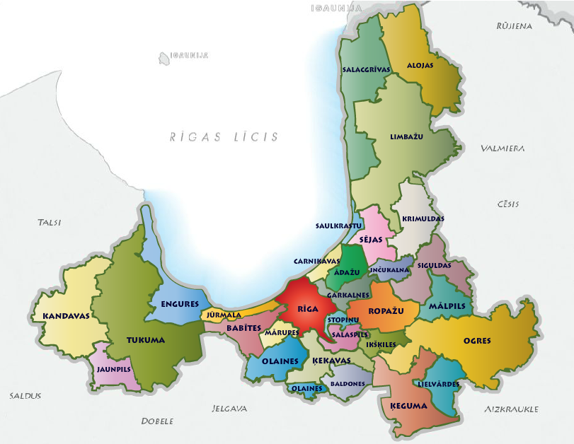
Boosting Cross Border Entrepreneurial Activity in Social and Creative Industries Sector (Social&Creative)
Project partners
Lead partner – Riga Planning region (LV, abbreviation - RPR)
Riga Planning Region as an institution is a derived public entity, which is supervised by the Ministry of Environmental Protection and Regional Development of the Republic of Latvia. Its primary task is to co-ordinate regional development processes in the fields of physical, economic and transport planning, support to entrepreneuship as well as
development and implementation of projects, in co-operation with 30 local municipalities that are located within
the boundaries of the region.
Partner budget within the Project –
95,712.00 Eur, including 85% ERDF
co-financing.

Slide 5
Boosting Cross Border Entrepreneurial Activity in Social and Creative Industries Sector (Social&Creative)
Project partners (continued)
Partner - Latvian New Entrepreneurs' Centre "Jobs&Society" (LV, JUC/NEC)
In recent years, JUC/NEC has acquired extensive experience in the field of entrepreneurship and creative industries. They have led and managed several projects in this area and obtained a large amount of knowledge,
competences and know-how.
One of their strengths is the well-established link to entrepreneurs and a
large database that allows communicating and branding the project in a qualitative manner.
Partner budget within the Project –
16,350.00 Eur, including 85% ERDF
co-financing.

Slide 6
Boosting Cross Border Entrepreneurial Activity in Social and Creative Industries Sector (Social&Creative)
Project partners (continued)
Partner – University of Tartu (EE, abbreviation TU)
The University of Tartu, Chair of Entrepreneurship is responsible for
the organisation and coordination of educational, research, development and tutorial activities in the field of entrepreneurship in Southern Estonia.
The School of Economics and Business Administration of Tartu University, has long lasting experiences with teaching entrepreneurship and
supporting existing and new companies. Based on activities tested in practice, they have established their own original method, Entrepreneurship Home ™.
Partner budget within the Project –
43,067.50 Eur, including 85% ERDF
co-financing.

Slide 7
Boosting Cross Border Entrepreneurial Activity in Social and Creative Industries Sector (Social&Creative)
Project partners (continued)
Partner – Tartu Centre for Creative Industries (EE, abbreviation LMK)
The Tartu Centre for Creative Industries (TCCI) was founded on May 14th, 2009 by the Tartu City Council. TCCI operates as the coordinator of creative industries in Tartu and South Estonia by providing information and training, legal and economic expertise for creative entrepreneurs, as well as business incubation services.
One of the main focuses for TCCI’s business incubator is to explore export markets and search for partners that could collaborate with the young creative industries. These unique competencies also provide a blend of knowledge and experience in the field of social and creative entrepreneurs’ education, support and consulting.
Partner budget within the Project –
16,425.00 Eur, including 85% ERDF
co-financing.

Slide 8
Boosting Cross Border Entrepreneurial Activity in Social and Creative Industries Sector (Social&Creative)
Project Objective
The objective of the project is to establish and promote cross-border cooperation among social and creative entrepreneurs, thus propelling these business areas in Latvia and Estonia.
The project will strengthen entrepreneurial abilities to develop joint social and creative collaboration and have international mind-set by joint trainings and mentoring in respective countries, and spurring the sense of initiative, leadership and engagement within societal, creative and economical processes in cross – border sense in Latvia and Estonia.
Target Group
Social and Creative SME’s – 60, Social and Creative business ideas owners (potential start-ups) – 8, Local public Authorities – 10, General public – 300 persons.

Slide 9
Boosting Cross Border Entrepreneurial Activity in Social and Creative Industries Sector (Social&Creative)
Programme Output Indicators and Project Contribution
Programme Output Indicator | Project Target / Programme Target (Total) | Project Target by Project Activity
Participants at project events, except management meetings | 170 / 500 | 80 - T1.1.1; 40 - T2.1.1; 50 - T3.1.1
Jointly organised events, except management meetings | 9 / 30 | 4 - T1.2.1; 4 - T2.2.1; 1 - T3.2.1
Number of enterprises receiving non-financial support | 30 / 125

Slide 10
Boosting Cross Border Entrepreneurial Activity in Social and Creative Industries Sector (Social&Creative)
Main Activities and Work Packages
The project is built around four work packages, including the management package, that each consist of several activities, groups of activities or sub-activities and complement each other in a way that ensures mutual continuity, logical interaction and create preconditions for the transfer of knowledge and experience gained during the implementation of the project among social an creative entrepreneurs of Estonia and Latvia.
WP M – Management;
WP T1 - Matchmaking seminars and contact making trips;
WP T2 - Joint training events ”To be the cross - border starter”;
WP T3 – Publicity.

Slide 11
Boosting Cross Border Entrepreneurial Activity in Social and Creative Industries Sector (Social&Creative)
WP M – Management
The management package includes administrative management of the project, coordination among Project partners, communication with the Joint
Secretariat and the MA, elaboration of project reports, project accountancy and financial management, public procurement procedures, as well as timing, monitoring and control.
Partner | WP M
RPR | 38,250.00
JUC / NEC | 7,500.00
UT | 13,680.00
LMK | 7,200.00
TOTAL EUR | 66,630.90
Percentage of Total Budget | 38.83%

Slide 12
Boosting Cross Border Entrepreneurial Activity in Social and Creative Industries Sector (Social&Creative)
WP T1 - Matchmaking seminars and contact making trips
This work package is one of the most substantial sets of activities within the structure of the project. The purpose of matchmaking seminars is to bring together the existing Estonian and Latvian social and creative entrepreneurs (stand-ups) with the aim to present common features of social and creative business models, develop possible cooperation platforms and debate how to decrease the negative effects that affect social and creative entrepreneurs in peripheral localities. During exchanges, the participants will share their best practices, establish new communication channels and cross-border partnerships.
Partner | WP T1
RPR | 13,444.80
JUC / NEC | 5,850.00
UT | 13,780.00
LMK | 5,625.00
TOTAL | 38,699.80
Percentage of Total Budget | 22.55 %

Slide 13
Boosting Cross Border Entrepreneurial Activity in Social and Creative Industries Sector (Social&Creative)
WP T1 - Matchmaking seminars and contact making trips
Responsible partner – RPR, involved partners – JUC/NEC, TU, LMK.
WP1 includes 4 jointly organised events: two matchmaking seminars (1 in Latvia, 1 in Estonia) and 2 contact making trips (1 trip to Latvia, 1 to Estonia).
Activity T1.1. – Matchmaking seminars in Estonia and Latvia. Target group: existing social and creative business owners. Expected output: established potential cross-border partnerships. Event duration: 1 day; event location: 1st in Latvia and 2nd in Estonia. Number of participants: 20 Latvian and 10 Estonian (in the 1st seminar in Latvia; 10 Latvian and 20 Estonian in the 2nd seminar in Estonia) social and creative industry enterprises, in total 60 entrepreneurs.
Activity T1.3. Contact making trips to Estonia and Latvia. Target group: existing social and creative business owners, representatives of municipalities. Expected output: established contacts, potential cross-border partnerships. Event duration: 2 days Location of the events: 1 exchange trip to Latvia, 1 to Estonia Number of participants: 17 Latvian and 17 Estonian social and creative industry enterprises; 5 representatives from Estonian and 5 from Latvian municipalities; in total 34 entrepreneurs and 10 representatives of municipalities.

Slide 14
Boosting Cross Border Entrepreneurial Activity in Social and Creative Industries Sector (Social&Creative)
WP T2 - Joint training events ”To be the cross - border starter”
Joint training events “To be the cross-border starter” are intended for the development of key competencies that allow successful cross-border entrepreneurial activity in social and creative industries for start-ups and idea owners. The training will presume non-formal learning approach focused on personal potential, capacity building, and especially on self-expression. Trainings will be based on partners' experiences. Training events will be conducted in 1 cycle of 4 events. 46 participants from both Latvia and Estonia will be selected for higher performance of cross-border cooperation. Training will concentrate on social and creative industries in the field of manufacturing and public and private services supply.
Partner | WP T2
RPR | 14, 545.20
JUC / NEC | 1,750.00
UT | 11,702,50
LMK | 1,750.00
TOTAL | 29,747.70
Percentage of Total Budget | 17.34%

Slide 15
Boosting Cross Border Entrepreneurial Activity in Social and Creative Industries Sector (Social&Creative)
WP T2 – Joint Training Events – ‘’To Be the Cross-Border Starter’’
Responsible partner – TU, involved partners – RPR, JUC/NEC, LMK.
WP2 includes Training events will be conducted in 1 cycle of 4 events. 46 participants from both Latvia and Estonia will be selected for higher performance of cross-border cooperation. Topics to be covered: 1) initiative, 2) creativity and innovation, 3) complex problem solving, 4) self-management, 5) effective communication, 6) starting business, 7) cross-border and international cooperation, 8) successful business-thinking.
Activity T2.1.The opening training event in Latvia (two days).
Activity T 2.2. Two one-day training events in Estonia.
Activity T2.4. One-day cycle closure event in Latvia.
Target group: start-ups and idea owners, municipal entrepreneurship specialists. Number of participants: 20 Latvian and 20 Estonian entrepreneurs or idea owners that represent social and creative industries, 3 Latvian and 3 Estonian municipalities.

Slide 16
Boosting Cross Border Entrepreneurial Activity in Social and Creative Industries Sector (Social&Creative)
WP T3 - Publicity
This package includes 3 groups of activities: a) development of the Joint promotional material “Social and creative”, b) a project closure event – trade fair, c) general publicity and promotion. All activities are considered as dissemination and promotion activities and have been combined in a single package in order to ensure more effective and cohesive development and publicity policy.
Partner | Budget WP T3
RPR | 24,471.10
JUC / NEC | 1,250.00
TU | 3,905.00
LMK | 1,850.00
TOTAL | 31,476.10
Percentage of Total Budget | 18.34 %

Slide 17
Boosting Cross Border Entrepreneurial Activity in Social and Creative Industries Sector (Social&Creative)
WP T3 – Publicity
Responsible partner – RPR, involved partners – UT, JUC/NEC, LMK.
This package includes 3 groups of activities that are considered as dissemination and promotion activities and have been combined in a single package in order to ensure more effective publicity policy.
Activity T3.1. –Joint promotional material “Social and creative”. The best ideas for cooperation or practices developed by project participants will be selected and described in the promotional material (a brochure) on creative and social entrepreneurship in Estonia and Latvia.
Activity T3.2. Project closure event – Trade fair material “Social and creative”. The trade fair will be organized with the purpose to allow creative and social entrepreneurs showcase and demonstrate their products and services, meet potential partners and customers, learn about others’ activities in the field and discuss recent market trends and opportunities. This 1 day event will be held in Latvia
Activity T2.4. General publicity and promotion. This particular group of activities will also provide for the following outputs: a publicity plan, a project logotype, representation materials, for instance, stationery with project logotype, canvas bags with project logotype, project banner, press releases or publications in local media.

Slide 18
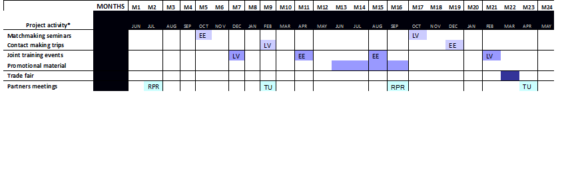
Boosting Cross Border Entrepreneurial Activity in Social and Creative Industries Sector (Social&Creative)
Project Schedule

Slide 19
Boosting Cross Border Entrepreneurial Activity in Social and Creative Industries Sector (Social&Creative)
Project Budget – Budget Lines
BL1 – Staff Costs. Expenditure on costs of staff members employed by the partner organisation, who are formally engaged to work on the project: either full-time or part-time.
BL2 – Office and Administrative Expenditure. This budget line includes office rent and supplies, communication, maintenance of IT systems, utilities, etc.
BL3 – Travel and Accommodation costs. Travel and accommodation costs must clearly link to the project and be essential for effective delivery of the project activities. These costs can be covered only for persons who are directly related to project activities; includes daily allowances for persons who are working in partner organisations based on employment contracts.
BL4 – External Expertise and Services Costs. Expenditure for the financing of external expertise and services provided by a public or private body or a natural person outside of the partner organisation. All types of costs related to external experts (e.g. travel and accommodation expenses for external experts) must be foreseen in the service contract and recorded under this budget line.

Slide 20
Boosting Cross Border Entrepreneurial Activity in Social and Creative Industries Sector (Social&Creative)
Project Budget by Budget Line
Partner | Staff Costs | Office and Administrat. | Travel and Accommod. | External Services | Total (EUR)
RPR | 37,686.00 | 5,652.90 | 5,430.00 | 46,943.10 | 95,712.00
JUC / NEC | 16,050.00 | 0 | 300.00 | 0 | 16,350.00
TU | 21,050.00 | 3,157.50 | 8,300.00 | 10,560.00 | 43,067.50
LMK | 15,825.00 | 0 | 600.00 | 0 | 16,425.00
TOTAL | 90,611.00 | 8,810.40 | 14,630.00 | 57,503.10 | 171,554.50
Percentage | 52.81 % | 5.13 % | 8.52 % | 33.51 % | 100.00 %

Slide 21
Boosting Cross Border Entrepreneurial Activity in Social and Creative Industries Sector (Social&Creative)
Ilgvars Francis
Project Co-Ordinator at Riga Planning Region
Tālr. +371 29229690; e-mail: ilgvars.francis@rpr.gov.lv
www.rpr.gov.lv
Notes:
Sadarbība ar partneriem n

